Slide 1

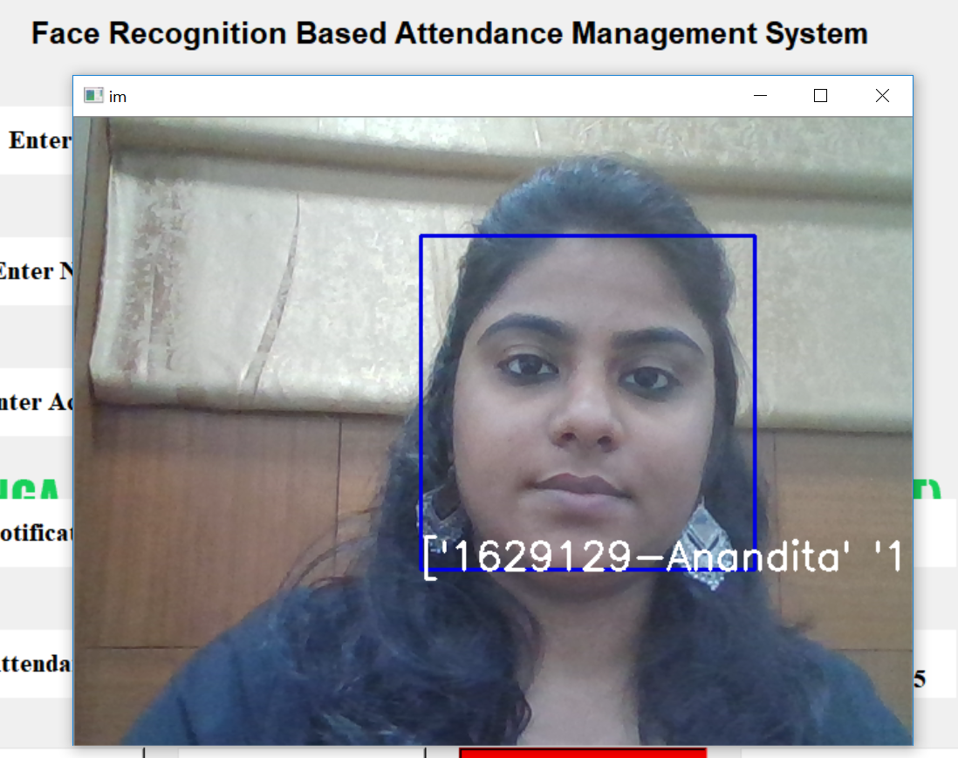
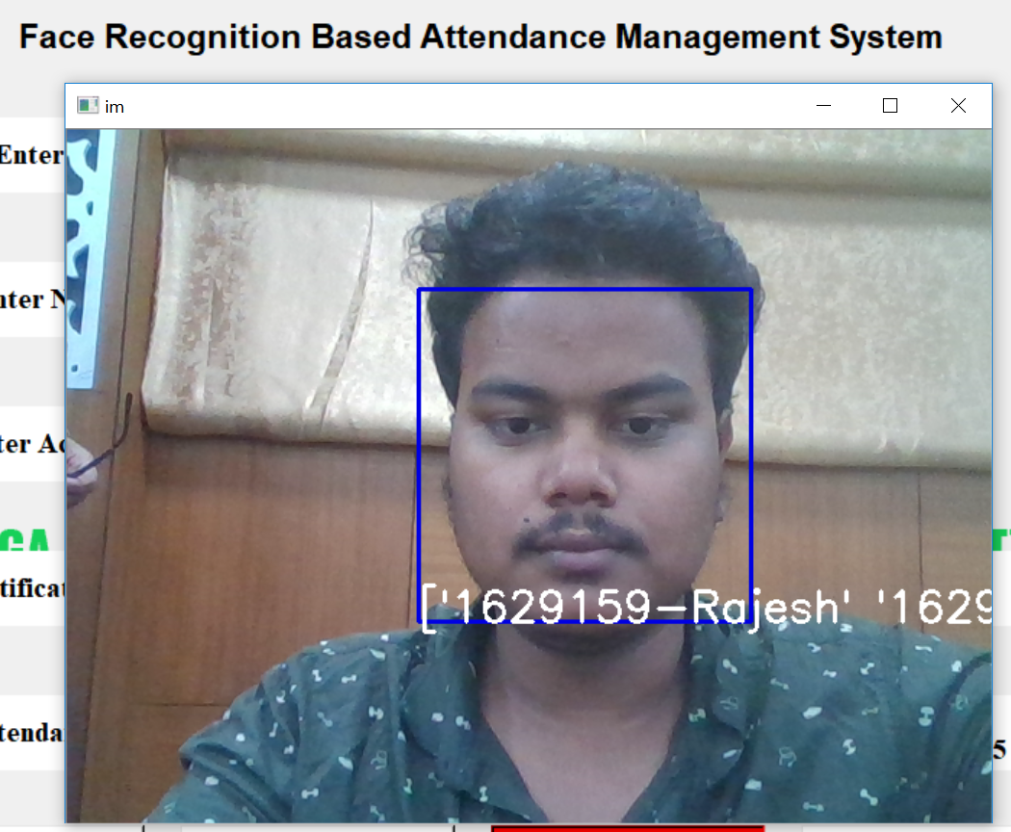
Face Recognition Based Attendance System
By: Team-ZeroBug
Anandita Sachdeva(1629129) Rajesh Mohanty(1629159)

Slide 2
Abstract:
The most difficult/laborious task in any organization is the attendance marking. In this presentation we proposed an automated attendance management system which tackles the predicament of recognition of faces in biometric systems subject to different real time scenarios such as illumination, rotation and scaling. This model incorporates the laptop webcam that captures input image, an algorithm to detect a face from the input image, encode it and recognize the face and mark the attendance in a spreadsheet. The system camera of the laptop takes user details and captures the image as an input and then sends it to the database. During the attendance the faces are recognized from the database and attendance is marked on basis of it.

Slide 3
Introduction:
Face recognition is a biometric technique which involves determining if the image of the face of any given person matches any of the face images stored in a database. This problem is hard to solve automatically due to the changes that various factors, such as facial expression, aging and even lighting, can cause on the image. Among the different biometric techniques facial recognition may not be the most reliable but it has several advantages over the others.It is widely used in various areas such as security and access control, forensic medicine, police controls and in attendance management system. The various techniques for marking attendance are:
1) Signature based System
2) Fingerprint based System
3) Iris Recognition
4) RFID based System
5) Face Recognition

Slide 4
Face Recognition:
Face recognition is an easy task for humans. Experiments in [Tu06] have shown, that even one to three day old babies are able to distinguish between known faces. So how hard could it be for a computer? It turns out we know little about human recognition to date. Are inner features (eyes, nose, mouth) or outer features (head shape, hairline) used for a successful face recognition? How do we analyze an image and how does the brain encode it? It was shown by David Hubel and Torsten Wiesel, that our brain has specialized nerve cells responding to specific local features of a scene, such as lines, edges, angles or movement. Since we don’t see the world as scattered pieces, our visual cortex must somehow combine the different sources of information into useful patterns. Automatic face recognition is all about extracting those meaningful features from an image, putting them into a useful representation and performing some kind of classification on them.
Following Machine Learning libraries/methods are used in proposed model:
Numpy, Pandas (Basic Machine Learning libraries used to deal with Arrays & Data analysis).
OpenCV (Open Source Computer Vision: used for real time Image Processing).
Pillow (Used for Image Manipulation).

Slide 5
OpenCV(Open Source Computer Vision):
OpenCV (Open Source Computer Vision) is a popular computer vision library started by Intel in 1999. The cross-platform library sets its focus on real-time image processing and includes patent-free implementations of the latest computer vision algorithms. OpenCV is released under a BSD license so it is used in academic projects and commercial products alike.
OpenCV 2.4 now comes with the very new FaceRecognizer class for face recognition, so you can start experimenting with face recognition right away.
OpenCV was designed for computational efficiency and with a strong focus on real-time applications. Written in optimized C/C++, the library can take advantage of multi-core processing. Enabled with OpenCL, it can take advantage of the hardware acceleration of the underlying heterogeneous compute platform.

Slide 6
OpenCV Face Recognizers:
Thanks to OpenCV, coding facial recognition is now easier than ever. There are three easy steps to computer coding facial recognition, which are similar to the steps that our brains use for recognizing faces. These steps are:
Data Gathering: Gather face data (face images in this case) of the persons you want to identify.
Train the Recognizer: Feed that face data and respective names of each face to the recognizer so that it can learn.
Recognition: Feed new faces of that people and see if the face recognizer you just trained recognizes them.
Here are the names of those face recognizers and their OpenCV calls:
EigenFaces – cv2.face.createEigenFaceRecognizer()
FisherFaces – cv2.face.createFisherFaceRecognizer()
Local Binary Patterns Histograms (LBPH) – cv2.face.createLBPHFaceRecognizer()

Slide 7
Face Detection using Haar Cascades:
Object Detection using Haar feature-based cascade classifiers is an effective object detection method proposed by Paul Viola and Michael Jones in their paper, "Rapid Object Detection using a Boosted Cascade of Simple Features" in 2001. It is a machine learning based approach where a cascade function is trained from a lot of positive and negative images. It is then used to detect objects in other images.
OpenCV comes with a trainer as well as detector. If you want to train your own classifier for any object like car, planes etc. you can use OpenCV to create one. Its full details are given here: Cascade Classifier Training.
Here we will deal with detection. OpenCV already contains many pre-trained classifiers for face, eyes, smiles, etc. Those XML files are stored in the opencv/data/haarcascades/ folder.

Slide 8
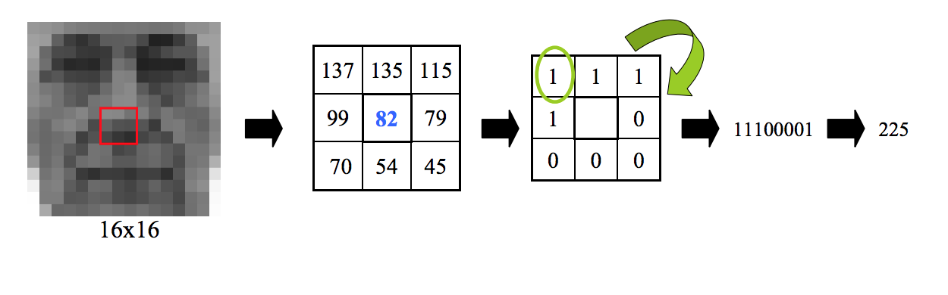
LOCAL BINARY PATTERNS HISTOGRAMS (LBPH) FACE RECOGNIZER:
Take a 3×3 window and move it across one image. At each move (each local part of the picture), compare the pixel at the center, with its surrounding pixels. Denote the neighbors with intensity value less than or equal to the center pixel by 1 and the rest by 0.
After you read these 0/1 values under the 3×3 window in a clockwise order, you will have a binary pattern like 11100011 that is local to a particular area of the picture. When you finish doing this on the whole image, you will have a list of local binary patterns.

Slide 9
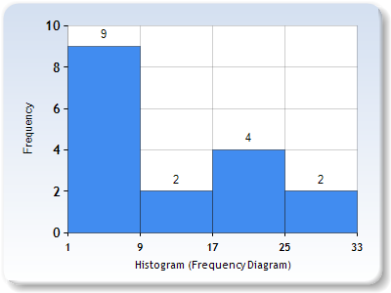
Now, after you get a list of local binary patterns, you convert each one into a decimal number using binary to decimal conversion (as shown in above image) and then you make a histogram of all of those decimal values.
In the end, you will have one histogram for each face in the training data set. That means that if there were 100 images in the training data set then LBPH will extract 100 histograms after training and store them for later recognition. Remember, the algorithm also keeps track of which histogram belongs to which person.
Later during recognition, the process is as follows:
Feed a new image to the recognizer for face recognition.
The recognizer generates a histogram for that new picture.
It then compares that histogram with the histograms it already has.
Finally, it finds the best match and returns the person label associated with that best match.

Slide 10
Conclusion:
The proposed model is hassle free, scalable, has a minor inital investment and has a very low maintenance cost and is reliable most of the times, and with regular backups the school can reduce the impact of data loss.
Parents can track their ward’s daily attendance via mail. Also the chances of proxies in the classroom will be eradicated.
In addition it decreases the time teachers spend while taking the manual attendance and they can focus more towards teaching.

